Slide 1
Team Id: H26EDU10
Project Title - VerifyEdu
Team Lead Name - Mustafa Sethjiwala
Team Members Name - Subham Kumar Gupta, Sneha Arya
College Name - National Institute of Technology, Tiruchirappalli

Slide 2
Problem Statement
Students can use AI tools to do their assignments without having any real knowledge of the subject. There is no way to check whether the student has really learned the concepts.
Objective of our solution
Verify genuine student understanding, not just detect AI-generated text
Generate assignment-specific quizzes automatically using AI.

Slide 3
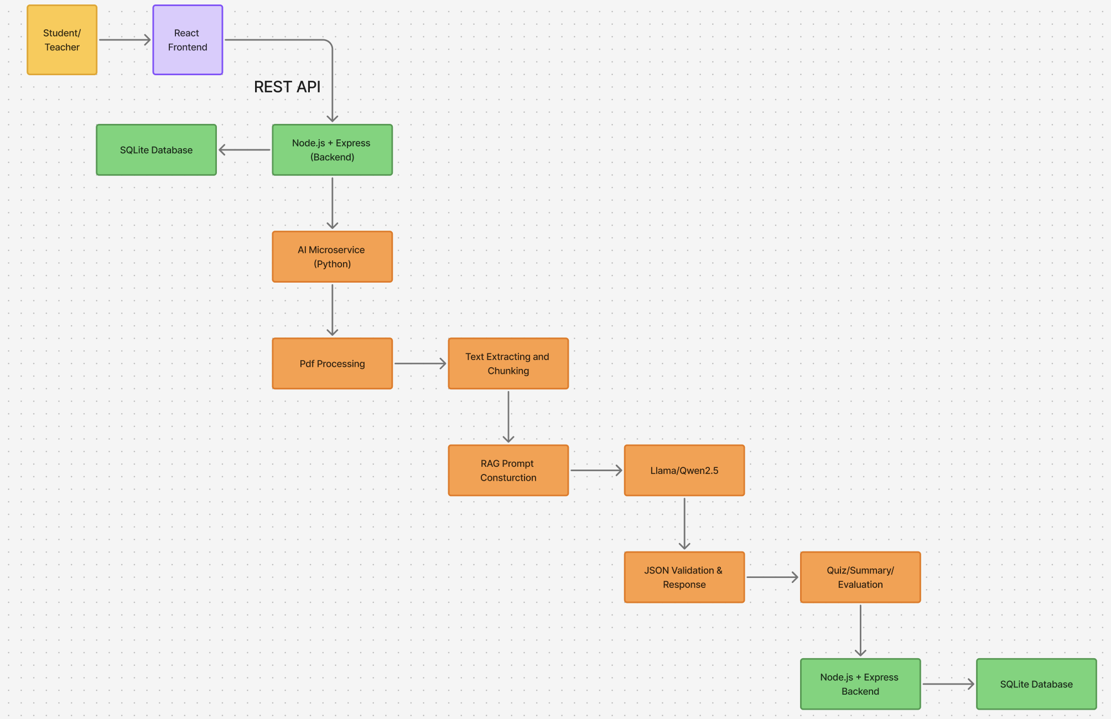
Block
diagram

Slide 4
Algorithms/Techniques
For Text Chunking
Rule based sentence boundary detection
Greedy Sliding Window chunking
Sliding window chunking with overlap
For Embedding Generation
Transformer-based sentence embedding (all-MiniLM-L6-v2)
Mean pooling
L2 Normalizing
Vector Storage and retrieval
FAISS vector indexing
Cosine similarity

Slide 5
Algorithms/Techniques
For Ollama + LLM Quiz generation
Temperature controlled sampling
RAG based grounding
For Answer evaluation
Semantic similarity
Keyword coverage matching
Concept-Term set overlap (Jaccard-style similarity)

Slide 6
Technology Stack
Frontend
React + Vite
Tailwind CSS
React router
Axios
Backend
Node.js
Express.js
Prisma ORM
JWT authentication
Multer (pdf upload)
Database
SQLite
AI & Machine learning
Python (FastAPI)
Llama & Qwen2.5 (via Ollama)
FAISS (Vector database)
Scikit-learn (TF-IDF & Cosine similarity)

Slide 7
Technology Stack
Communication
REST APIs
Document Processing
PyMuPDF (PDF Text Extraction)
Recursive Text Chunking
RAG (Retrieval-Augmented Generation)

Slide 8
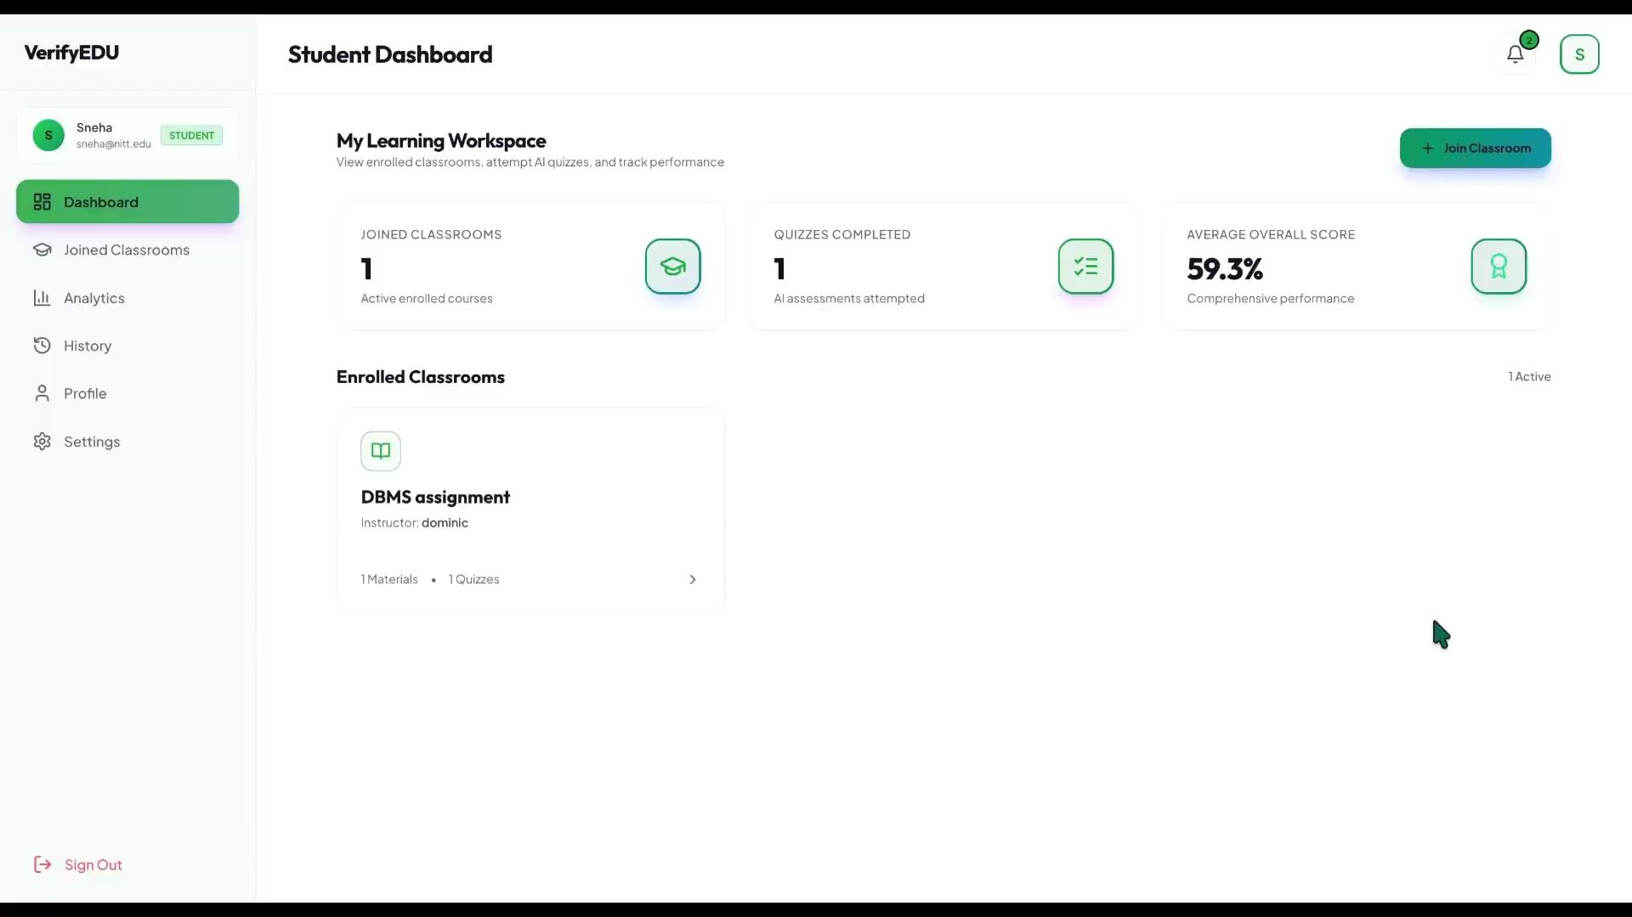
Results

Slide 9
Comparison with existing solution
Feature | Turnitin | VerifyEdu
Detects AI-Written text | Yes | Not the goal
Verifies student understanding | No | Yes
Personalized to actual submission | No | Yes
Gives teachers actionable next step | Just a probability score | Comprehension score + quiz results
False positives penalizer honest students | Yes (18% for ESL students) | Doesn’t accuse, it tests

Slide 10
Summary & Future Work
VerifyEdu generates AI quizzes grounded in a teacher's own study material (RAG-based, no hallucination) and grades descriptive answers with semantic + keyword scoring — giving teachers a real comprehension signal, not just a % score.
Future Work
Quiz reliability layer - Source-evidence verification and a secondary LLM pass, so every generated question is checked against the source text before students see it.
Human-in-the-loop review - Teachers preview and approve/edit auto-generated questions before they reach students, as a manual check on top of the automated reliability layer.
Difficulty-weighted scoring - Weight questions by conceptual depth instead of flat % correct, for a more accurate comprehension.
LMS integration - Plug into Google Classroom so teachers don't need a separate tool.

